Slide 1
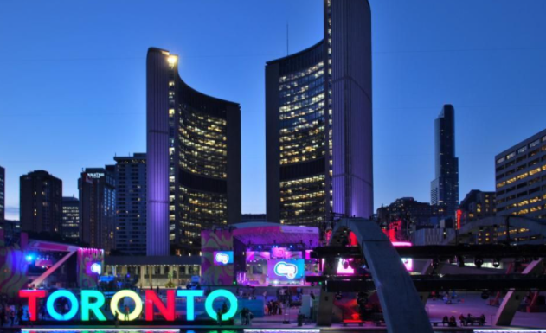
Finding the best neighborhood to set up a Coffee Shop that specialized in Kopi Luwak

Slide 2

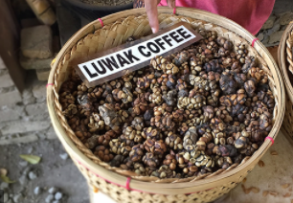
Set up a coffee shop in Toronto is extremely competitive due to the following :
People generally go to coffee shops where they always visit (household brand)
People might find it over rating to start another coffee shop in the existing neighborhood (High volume of existing coffee shop)
People like to seek out for the latest invention of coffee shops, but many failed coffee shops failed to come up with new idea (unique feature)

Slide 3


Data acquisition and cleaning
For this project we need the following data:
1. Toronto City data that contains Borough, Neighbourhoods along with there latitudes and longitudes
Data Source: https://en.wikipedia.org/wiki/List_of_postal_codes_of_Canada:_M
Description: This Wikipedia page contain all the information we need to explore and cluster the neighbourhoods in Toronto. We will be required to scrape the Wikipedia page and wrangle the data, clean it, and then read it into a pandas data frame so that it is in a structured format like the Toronto dataset.
2. Geographical Location data using Geocoder Package
Data Source: https://cocl.us/Geospatial_data
Description: The second source of data provided us with the Geographical coordinates of the neighbourhoods with the respective Postal Codes.
3. Venue Data using Foursquare API
Data Source: https://foursquare.com/developers/apps
Description: From Foursquare API we can get the name, category ,latitude ,longitude for each venue.

Slide 4
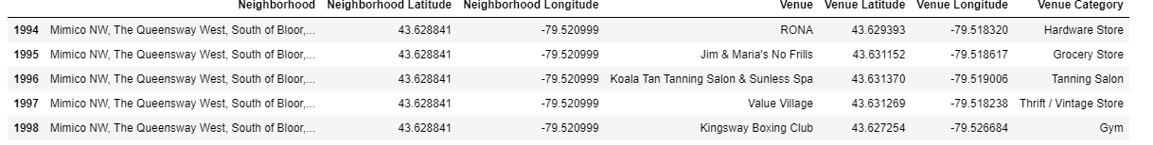
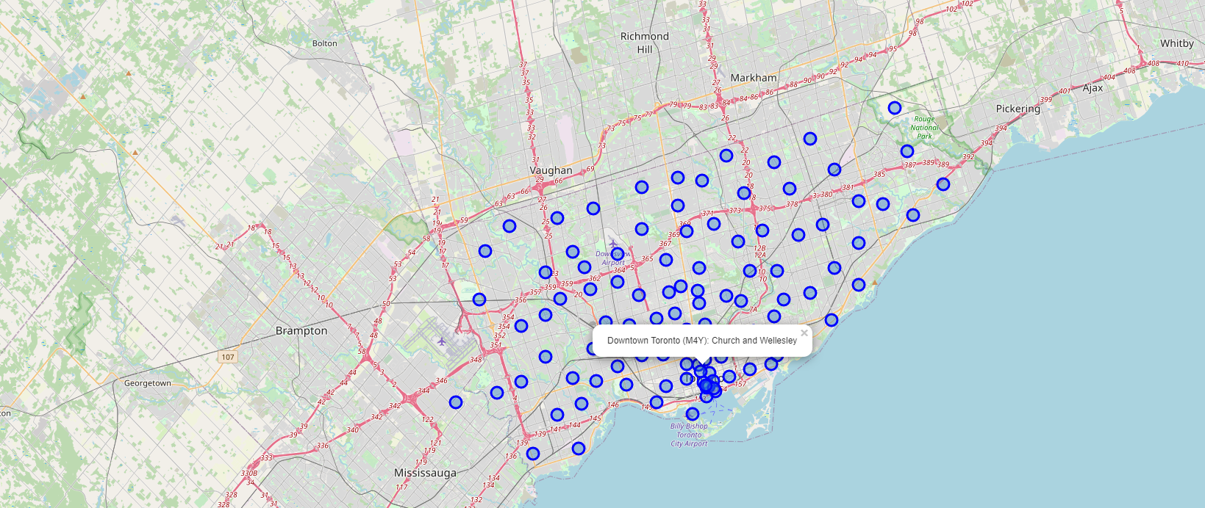
Methodology (1)
Cluster all the neighbourhoods within a radius of 500 m together.
Use of Folium API to generate this map

Slide 5
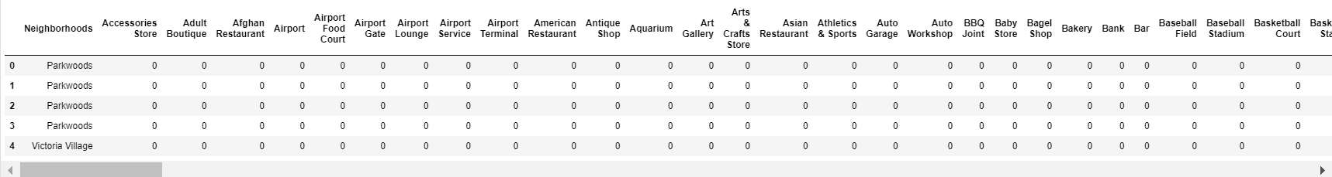
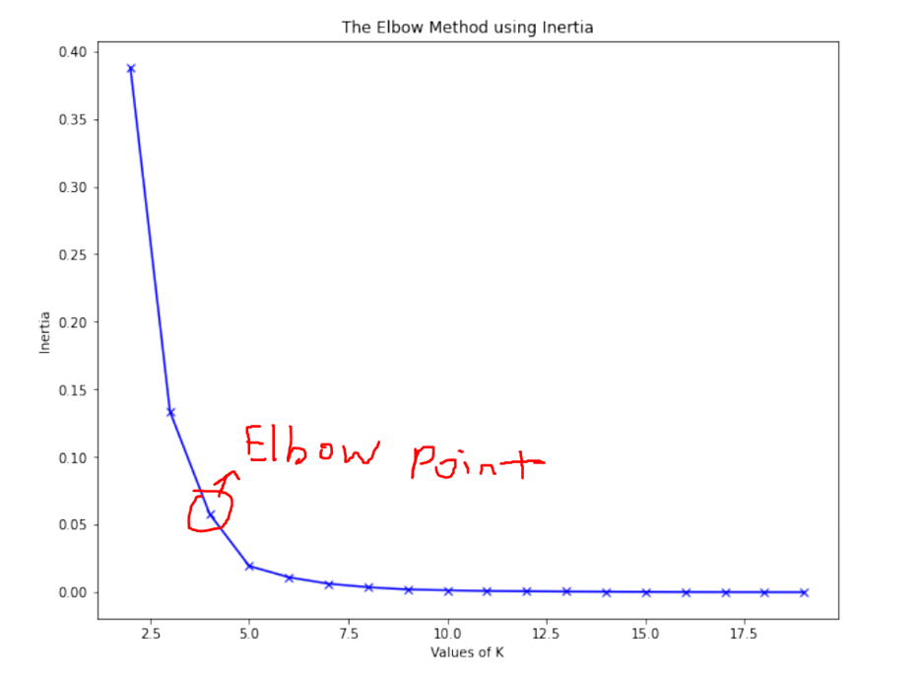
Methodology (2)
Use of One Hot Encoding (Data Pre- Processing)
Use of Elbow Method to find the no. of clustering

Slide 6
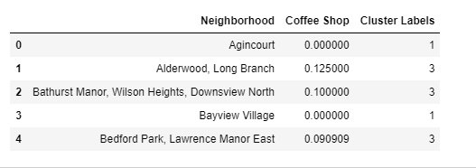
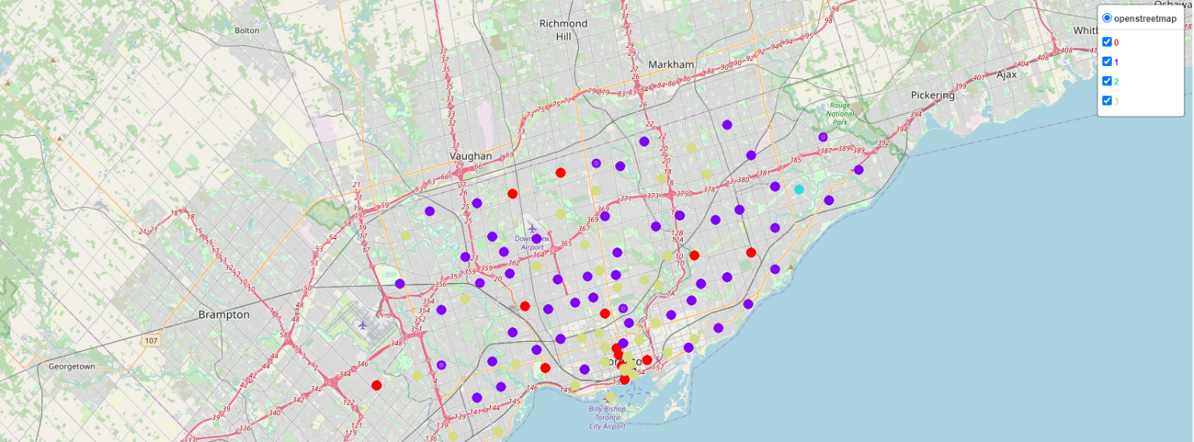
Methodology (3)
Using Data Frame to show the cluster labels
Using Folium API to show the clustering

Slide 7
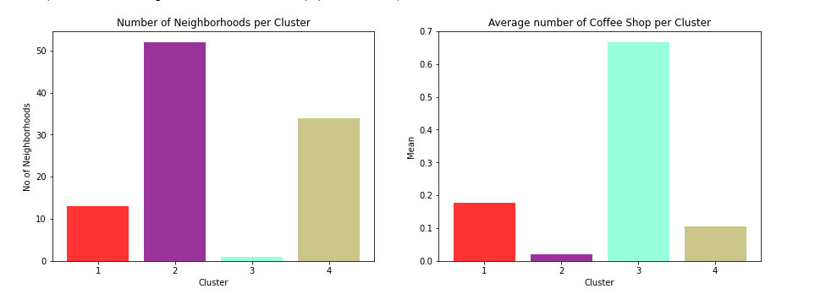
Results
Based on these two bar charts show that the coffee shop (Kopi Luwak) is best to set-up in cluster 2 (North York) due to the high number of neighbourhood and least number of existing coffeeshop in the area. However, if the coffee shop owner is confident that his coffee has the competitive edge over other competitors in term of delivering the top-notch coffee breed and exclusive to those who feel appreciate for the quality, he may choose to opt for cluster 3 (Scarborough).

Slide 8
Discussion
Using data visualization ,cleaning and extracting of data (information of Tornto) which we can showcase to our coffeeshop owner that we managed to find the highest volume of coffee shop in the Tornto and neighbourhoods through clustering. The purpose of clustering helps to determine a region where places which are nearby can be categorized together so that the data is more appealing and easier to understand as compared to several number of clusters with different names. With the presentation of this project, the coffee shop will gain a better understanding of where he can find the most strategized location to set up his store and ward off his competitors.

